Slide 1
Pushing back and pushing forward
Christine Sleeter
California State university Monterey Bay
Summer 2023 EDJE Conference

Slide 2
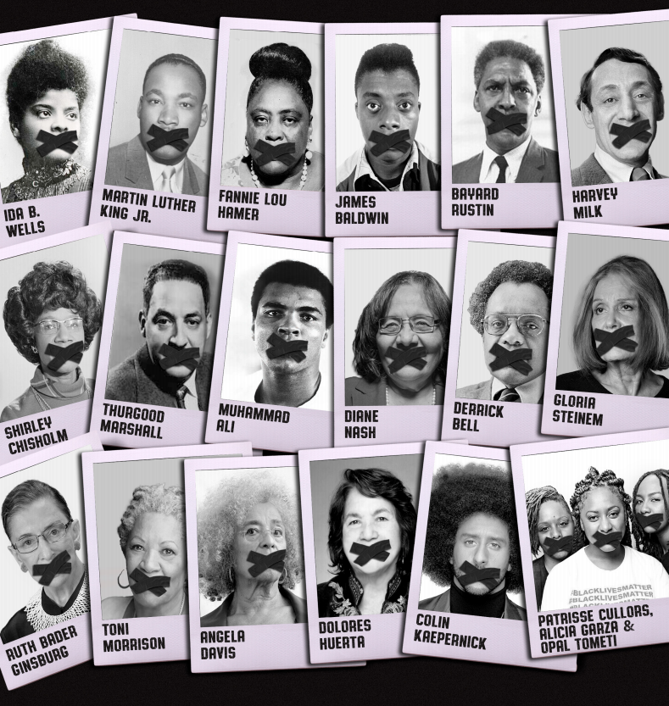

Slide 3
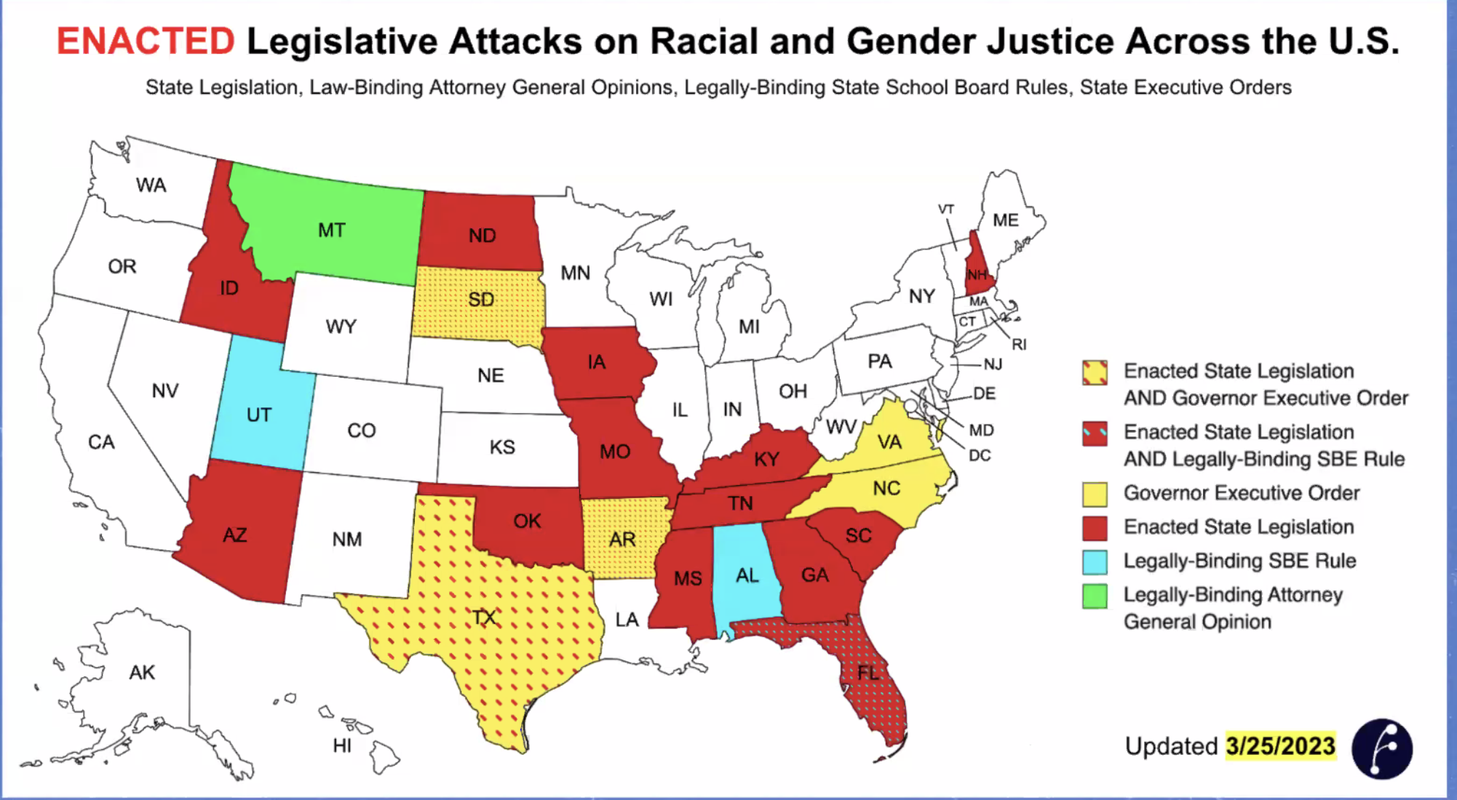
Source: African American Policy Forum

Slide 4
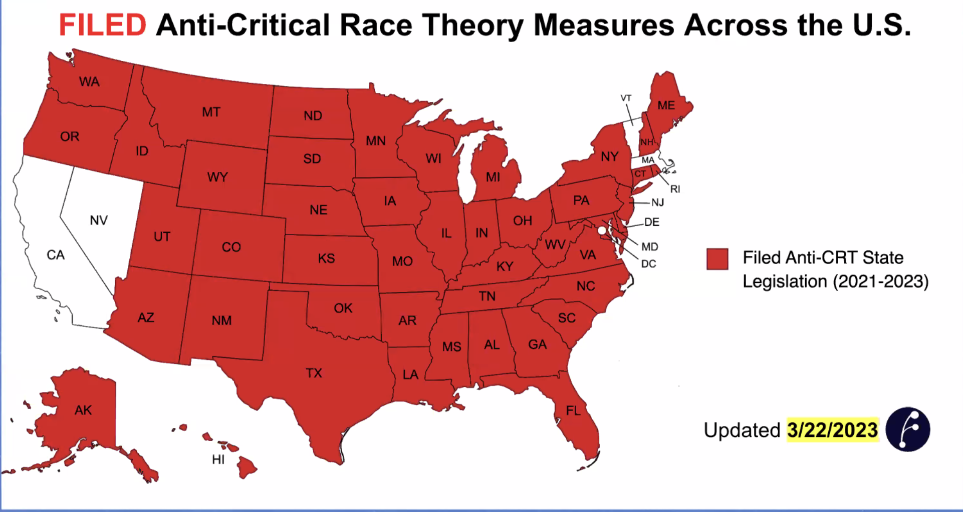
Source: African American Policy Forum

Slide 5
The Problem
Why the persistent a gap between:
teacher education programs claiming to prepare teachers for social justice and diversity
and the continued production of mainly White teachers minimally equipped to offer racially minoritized students a strong and culturally responsive education?

Slide 6
Critical Race Theory
A core premise of CRT is that racism is endemic, institutional, and systematic; racism is not an aberration, but rather a fundamental way of organizing society. This means that the continued production of teachers, large proportions of whom are not well-equipped to teach racially minoritized students well, is not an aberration.

Slide 7
Interest Convergence
Teacher education faculty about 78% white
416 US early childhood teacher preparation programs:
the more diverse the full-time faculty, the more likely coursework would focus on working with children and families from culturally diverse backgrounds
the whiter the faculty, the less likely coursework would have such a focus
Lin, C., Maxwell, K. L., Able-Boone, H., & Zimmer, C. R. (2009). Cultural and linguistic diversity in early childhood teacher preparation. Early Childhood Research Quarterly, 24(1), 64-76.

Slide 8
Interest Convergence
Teacher education faculty about 78% white
Curriculum content generally reflects white sensibilities; “diversity” coursework tends to be separate from rather than integral to the rest of the program

Slide 9
Interest Convergence
Gorski’s analysis of 45 syllabi for multicultural education:
16% assimilationist orientation, “Othering” language, no attention to systemic inequalities
58% celebratory orientation, celebration of differences with little or no attention to systemic inequalities
29% critical orientation: education analyzed within larger sociopolitical context
Gorski, P. (2009). What we’re teaching teachers: An analysis of multicultural education coursework syllabi. Teaching and Teacher Education.

Slide 10
Ethnic Studies Curriculum and Student Achievement
Author(s) | Curriculum | Level | Research Design | Outcome(s) | Impact
Dee, Penner, 2017 | SFUSD Ethnic Studies | 9th grade | Quasi-experimental | GPA, attendance, credits toward grad | Positive
Bonilla, Dee, Penner, 2021 | SFUSD Ethnic Studies | 9th grade | Longitudinal | Graduation, college attendance | Positive for graduation
Cabrera et al., 2014 | TUSD’s MAS program | High school | Quasi-experimental | Standardized tests, graduation rates | Positive
Cammarota, Romero, 2009 | TUSD’s Social Justice Ed Project | High school | Pre-post no control group, interviews | Test scores, grad rates, sense of empowerment | Positive
Kisker, et al., 2012 | Math in a Cultural Context | 2nd grade | Pre-post control group | Math achievement tests | Positive
Lipka, et al., 2005 | Math in a Cultural Context | 6th grade | Pre-post control group | Benchmark achievement texts | Positive
McCarty & Lee, 2014 | Native American Community Academy | Middle, H.S. | Qualitative; pre-post no control gp | Basic skills achievement | Positive
McCarty, 1993 | Rough Rock Navajo English-Lang Arts | Elem | Qualitative | Reading scores | Positive
Matthews & Smith, 1994 | Culturally relevant science, Am Indian | 4-8th grades | Pre-post control group | Science achievement, attitudes toward science & Native Americans | Positive
Green-Gibson & Collett, 2014 | African American cultural infusion | 3rd-6th grades | Causal comparative | School AYP | Positive

Slide 11
Ethnic Studies Curriculum and Student Achievement
Author(s) | Curriculum | Level | Research Design | Outcome(s) | Impact
Duncan, 2012 | Africentric U.S. history course | 8th grade | Quasi-experimental | Academic achievement, student self-efficacy | Positive
Baker, 2017 | Afrocentric curriculum | 3 ⁻ 5th | correlational | Reading scores | Positive
Rickford, 2001 | Culturally relevant texts | Middle school | Post-interviews, no control | Comprehension, higher order thinking | Positive
Tyson, 2002 | Multicultural literature in social studies class | Middle school | Interviews, classroom observations | Use of text, knowledge of social issues | Positive
Ginwright, 2000 | Afrocentric culture infused through curriculum and school | High school | Qualitative case study | Academic achievement, academic participation | No impact

Slide 12
Ethnic Studies and cross-racial attitudes of diverse populations
Ethnic studies, women’s studies usually have positive impact on attitudes about race
Students develop greater empathy for the group(s) the curriculum focuses on
Cross-group interaction strengthens positive impact
Impact greater on white student attitudes than on BIPOC student attitudes, although white students often struggle initially
Instruction taking students’ actual questions into account is more powerful than instruction that does not

